Slide 1


Flutter-Based Transportation Management
System
for Students, Drivers, and Admin
Presented by,
Surendar A, Swetha V
Tamilselvi P , Shahina F
B.E,CSE
Anna university-Chennai.
Guided by,
DR .VS . Thiyagarajan
Associate Professor
Karpaga Vinayaga College of Engineering and Technology-Chengalpattu Dt.,

Slide 2


ABSTRACT
This Flutter project is designed to manage and streamline the operations of a transportation system with three main modules: Student, Driver, and Admin. The Student module allows users to register, log in, and travel by selecting bus routes based on their location. It also provides features like real-time location tracking via Google Maps and viewing late form details. The Driver module enables registration and login for drivers to update trip start details, share their current location, submit late form updates, and track student attendance by scanning student ID QR codes. The Admin module provides an interface for administrators to log in and manage essential information such as driver, bus, student, attendance, and late form details. This project provides a comprehensive solution for managing transportation operations, improving efficiency, and ensuring seamless communication among students, drivers, and administrators.

Slide 3
INTROCDUCTION
This Flutter project is a comprehensive solution designed to streamline and manage the operations of a transportation system, catering to three key user roles: Students, Drivers, and Admins. The Student module enables users to register, log in, and select bus routes based on their location, with added features like real-time location tracking via Google Maps and viewing late form details. The Driver module allows drivers to register, log in, and update trip start information, share their current location, submit late form updates, and track student attendance through QR code scanning. The Admin module offers an interface for administrators to manage and oversee essential details such as driver and bus information, student data, attendance records, and late form submissions. This project enhances the efficiency of transportation management, promotes effective communication, and ensures smooth operation between students, drivers, and administrators.

Slide 4
EXISTING WORK ANALYSIS
Existing System | Proposed System
However, the quality of route planning services relies heavily on having correct data about transportation infrastructure. As many planned subway lines are being built across cities, there are conflicts between the actual conditions and the data provided by map apps for temporary bus stops, which may result in complaints against public transportation operators. However, it is difficult to tackle these complaints, as public transportation operators can obtain only inaccurate information about the locations of temporary bus stops. | The proposed project is a Flutter-based transportation management system designed to streamline operations for students, drivers, and administrators. The Student module allows registration, bus travel with location filtering, real-time tracking, and late form viewing. The Driver module includes features for updating trip details, sharing location, submitting late forms, and scanning student attendance via QR codes. The Admin module provides a centralized platform for managing and viewing information about drivers, buses, students, late forms, and attendance, improving overall system efficiency and communication.
Techniques: GIS FRAMEWORK | Techniques: Realtime database, MOBILE GPS TRACKING SYSTEM Firebase, Flutter , GOOGLE MAP API
Demerits: Cost efficient Low latency , configuration is complex | Merits: Efficiency is high, achieve realtime User friendly and dynamic configuration

Slide 5
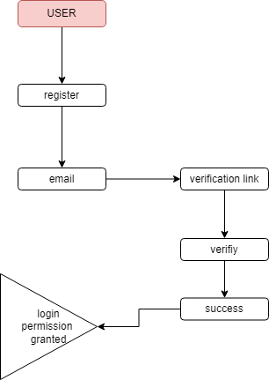
Flow Diagram
Student:

Slide 6

Driver:

Slide 7
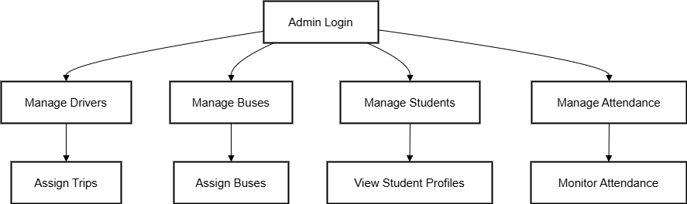
Admin:

Slide 8
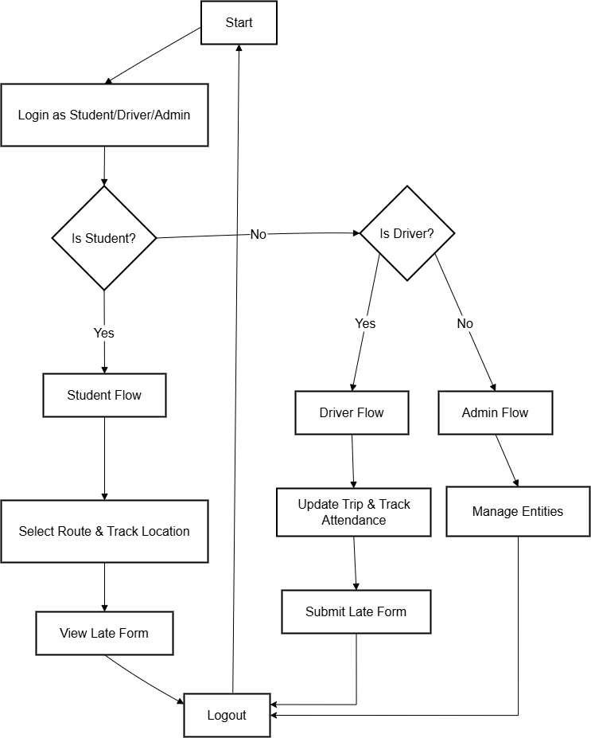
Activity Diagram

Slide 9
Module Description:
1.DRIVER:
Enables drivers to register, log in, update trip details, share their live location, manage late forms, and scan student QR codes for attendance tracking.
2.STUDENT:
Allows students to register, log in, and access services such as bus travel, location tracking via Google Maps, and viewing/submitting late forms for attendance issues.
3.ADMIN:
Provides a centralized platform for administrators to manage and oversee the entire transportation system, including driver profiles, bus assignments, student records, attendance, and late form submissions. Each module works together to streamline communication, data management, and operational efficiency across the transportation network.

